Slide 1
Object-Oriented using Java
Course Introduction
Session 0 - Course Introduction

Slide 2
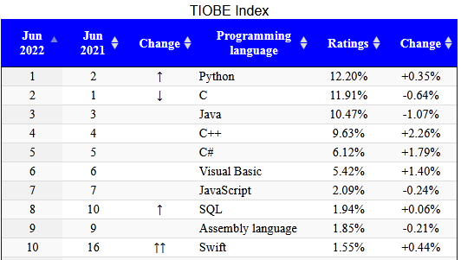
Why should you study Java?
Top ten common programming languages:
From https://statisticstimes.com/tech/top-computer-languages.php
Session 0 - Course Introduction

Slide 3
Why Java?
Java is Architecture Neutral (i.e. platform independent).
Java Provides “One-Stop Shopping” (customers can get all they need in just "one stop" ).
Java is Object-Oriented from the Ground Up.
Java is an Open Standard.
Java is Free!
Session 02 - Java Fundamentals

Slide 4
Instructor introduction
Name: Phan Đăng Cầu
Contacts:
Email: caupd@fpt.edu.vn
Mob: 0912 037 064

Slide 5
Course Overview
Prerequisite:
  Programming Fundamentals Using C

Slide 6
Course objectives
Introduce fundamental object-oriented (OO) terminology and concepts.
Getting to know the “World of Java”.
Understand the implementation of a Java Application.
Understand the roles of java built-in packages.
Session 0 - Course Introduction

Slide 7
Contents
Learning the Java Language
Classes and Objects
Nested Classes
Numbers and strings
Exceptions
Encapsulation
Inheritance
Polymorphism
Array of objects
Collections
Basic I/O
Session 0 - Course Introduction

Slide 8
Resources
Tool
  NetBean IDE 8.x
  JDK 1.8
Tutorial
  http://docs.oracle.com/javase/tutorial/
Session 0 - Course Introduction

Slide 9
Download & Install JDK & NetBeans
Downloads JDK 1.8 and earlier
https://www.oracle.com/java/technologies/javase/javase8-archive-downloads.html
Downloads NetBeans 8.2:
https://mega.nz/file/9aJhTYxa#vgitzVc5oiBZrUZTifDfE701KGUVkYNHQdnBLeG3BDg
You can also download JDK & NetBeans from the class PRO192_XXYY_CauPD in cmshn (e.g. PRO192_SU22_CauPD)

Slide 10
Course Requirements
Following lessons in classroom
Reading textbook and documents at home
Completing chapter assessment in time
Discussing actively in your teams and in classroom

Slide 11
Grading policy
On-going assessment:
- 6 Labs (LB): 10%
- 1 Assignments (AS): 20%
- 2 Progress tests (PT): 10%
Practical and Final Exams:
- 1 Practical Exam (PE): 30%
- 1 Final Exam (FE): 30%
Total score (TS) = 0.1*LB 0.2*AS + 0.1*PT + 0.3*PE + 0.3*FE
Completion Criteria:
1) Every on-going assessment (average) component > 0
2) PE > 0 (no resit)
3) FE >= 4 & TS >= 5

Slide 12
Academic policy
Cheating, plagiarism and breach of copyright are serious
offenses under this Policy.
Cheating
  Cheating during a test or exam is construed as talking, peeking at another student’s paper or any other clandestine method of transmitting information.
Plagiarism
  Plagiarism is using the work of others without citing it; that is, holding the work of others out as your own work.
Breach of Copyright
  If you photocopy a textbook without the copyright holder's permission, you violate copyright law.

